Slide 1
Unified Modeling Language - UML
University of Technical Education HCMC
Faculty of Information Technology
----o0o----
SOFTWARE DEVELOPMENT ENVIRONMENTS
Chapter 02
Lecturer: Nguyễn Trần Thi Văn
Notes:
Lecturer: Nguyễn Trần Thi Văn
Software Development Environments and Tools

Slide 2
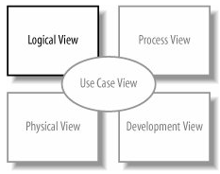
State machine Diagrams
Lesson 09
Notes:
Lecturer: Nguyễn Trần Thi Văn
Software Development Environments and Tools

Slide 3
Contents
Introduction
Notation
Transition variations
Internal transitions and behaviors
Composite states
Pseudo states
Protocol states
Notes:
Lecturer: Nguyễn Trần Thi Văn
Software Development Environments and Tools

Slide 4
Introduction
Also called state diagrams or statechart diagrams.
Are part of the logical view
Used to model states of an object and the events causing state changes.
Somehow similar to the activity diagrams
Notes:
Lecturer: Nguyễn Trần Thi Văn
Software Development Environments and Tools

Slide 5
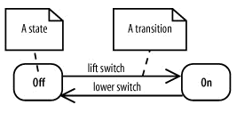
Notations
A state is represented by a rounded rectangle
A transition is denoted by an arrow, with its trigger above
Notes:
Lecturer: Nguyễn Trần Thi Văn
Software Development Environments and Tools

Slide 6
State Notation
A state with behavior – a “doing” state
Do behavior, written as do/behavior, is behavior that happens as long as the state is active
Playing
do/read disc
Notes:
Lecturer: Nguyễn Trần Thi Văn
Software Development Environments and Tools

Slide 7
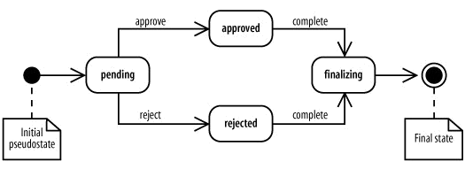
Initial pseudostate & final state
Used to mark the life-time of the object to be examined.
Notes:
Lecturer: Nguyễn Trần Thi Văn
Software Development Environments and Tools

Slide 8
Transition Notation
The full notation for transition descriptions is trigger[guard]/behavior
A trigger is an event that may cause a transition.
A guard is a boolean condition that permits or blocks the transition.
Transition behavior is an activity that executes during the transition.
Notes:
Lecturer: Nguyễn Trần Thi Văn
Software Development Environments and Tools

Slide 9
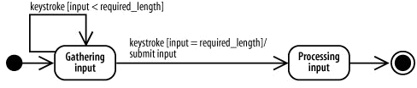
Transition Notation
An example about the user input process:
Notes:
Lecturer: Nguyễn Trần Thi Văn
Software Development Environments and Tools

Slide 10
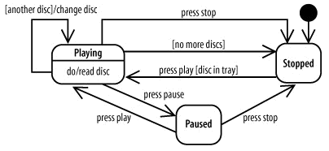
Transition variations
With a trigger name only
Notes:
Lecturer: Nguyễn Trần Thi Văn
Software Development Environments and Tools

Slide 11
Transition variations
With a trigger name and a guard condition. A guard will block a transition if it evaluates to false
Notes:
Lecturer: Nguyễn Trần Thi Văn
Software Development Environments and Tools

Slide 12
Transition variations
No trigger name: the transition is caused by the completion of the internal behavior.
Notes:
Lecturer: Nguyễn Trần Thi Văn
Software Development Environments and Tools

Slide 13
Transition variations
Guards are used to model choices between paths
Notes:
Lecturer: Nguyễn Trần Thi Văn
Software Development Environments and Tools

Slide 14
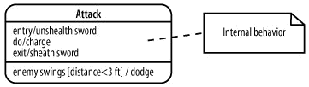
Internal behavior
Is any behavior that happens while the object is in a state.
Has the form of label / behavior
Label can be do, entry or exit
Notes:
Lecturer: Nguyễn Trần Thi Văn
Software Development Environments and Tools

Slide 15
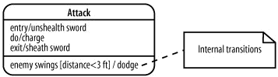
Internal transition
Is a transition that causes a reaction within a state, but doesn't cause the object to change states.
Different from self transition in that there are no entry and exit behavior.
Notes:
Lecturer: Nguyễn Trần Thi Văn
Software Development Environments and Tools

Slide 16
Composite states
UML allows concurrent states - being in multiple states at the same time.
Composite states enable modeling this situation.
A composite state is a state that contains one or more state diagrams.
Each diagram belongs to a region, and regions are divided by a dotted line.
Notes:
Lecturer: Nguyễn Trần Thi Văn
Software Development Environments and Tools

Slide 17
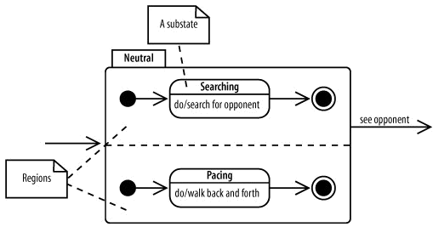
Composite states
Example:
Notes:
Lecturer: Nguyễn Trần Thi Văn
Software Development Environments and Tools

Slide 18
Composite states
How composite states work:
  When the composite state becomes active, the initial pseudostate of each region becomes active.
  The contained state diagrams begin executing.
  The contained state diagrams are interrupted if a trigger on the composite state occurs.
Notes:
Lecturer: Nguyễn Trần Thi Văn
Software Development Environments and Tools

Slide 19
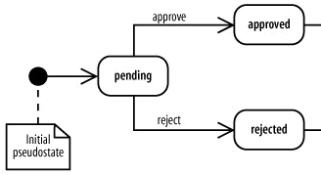
Pseudo states
Initial pseudostate: marks the beginning of the object’s lifetime
…
…
Notes:
Lecturer: Nguyễn Trần Thi Văn
Software Development Environments and Tools

Slide 20
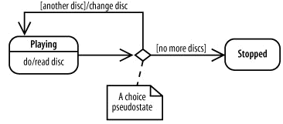
Pseudo states
Choice pseudostate: emphasizes that a Boolean condition determines which transition is followed.
Notes:
Lecturer: Nguyễn Trần Thi Văn
Software Development Environments and Tools

Slide 21
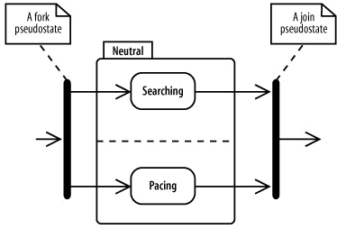
Pseudo states
Forks & joins pseudostate: shows concurrent states.
Notes:
Lecturer: Nguyễn Trần Thi Văn
Software Development Environments and Tools

Slide 22
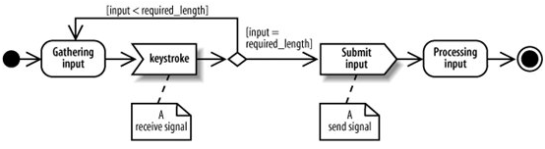
Signals
Just like in the activity diagrams, signals notation are used to emphasize the sending and receiving signals.
Notes:
Lecturer: Nguyễn Trần Thi Văn
Software Development Environments and Tools

Slide 23
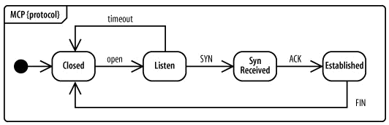
Protocol states
  Focus on showing a legal sequence of events and resulting states.
  Drawn in a tabbed rectangle with the name of the state machine in the tab followed by {protocol}
Notes:
Lecturer: Nguyễn Trần Thi Văn
Software Development Environments and Tools

Slide 24
Summary
States and transitions are main components of the state diagram.
States may have internal behaviors and transitions.
Composite states are used to model concurrents states.
Pseudo states are used in deciding the transitions
Notes:
Lecturer: Nguyễn Trần Thi Văn
Software Development Environments and Tools

Slide 25

Notes:
63
Lecturer: Nguyễn Trần Thi Văn
Software Development Environments and Tools

Slide 26
THE END
Notes:
Lecturer: Nguyễn Trần Thi Văn
Software Development Environments and Tools

